Slide 1

Performance Metrics: Driving Growth and Strategy
Clear, data-driven view of sales, profit, and KPIs to guide strategic decisions this quarter.

Slide 2

Executive Summary: The Performance Snapshot
Sales & Profit
KPI Drivers
Revenue growth across key regions; gross and net margin improvements in priority segments.
Top drivers: channel performance, product mix, and conversion rates from pipeline to closed deals.
Roadmap
Shift from raw metrics to automated, actionable insights—improve speed and accuracy of decisions.

Slide 3

KPI FRD: The Framework for Requirements
Purpose: Define financial KPIs, acceptable tolerances, data sources, and reporting cadence.
Mapping metrics to business outcomes (revenue, margin, CAC, LTV).
Department alignment: sales, finance, ops — single source of truth.
Data quality rules: validation, refresh frequency, ownership.

Slide 4
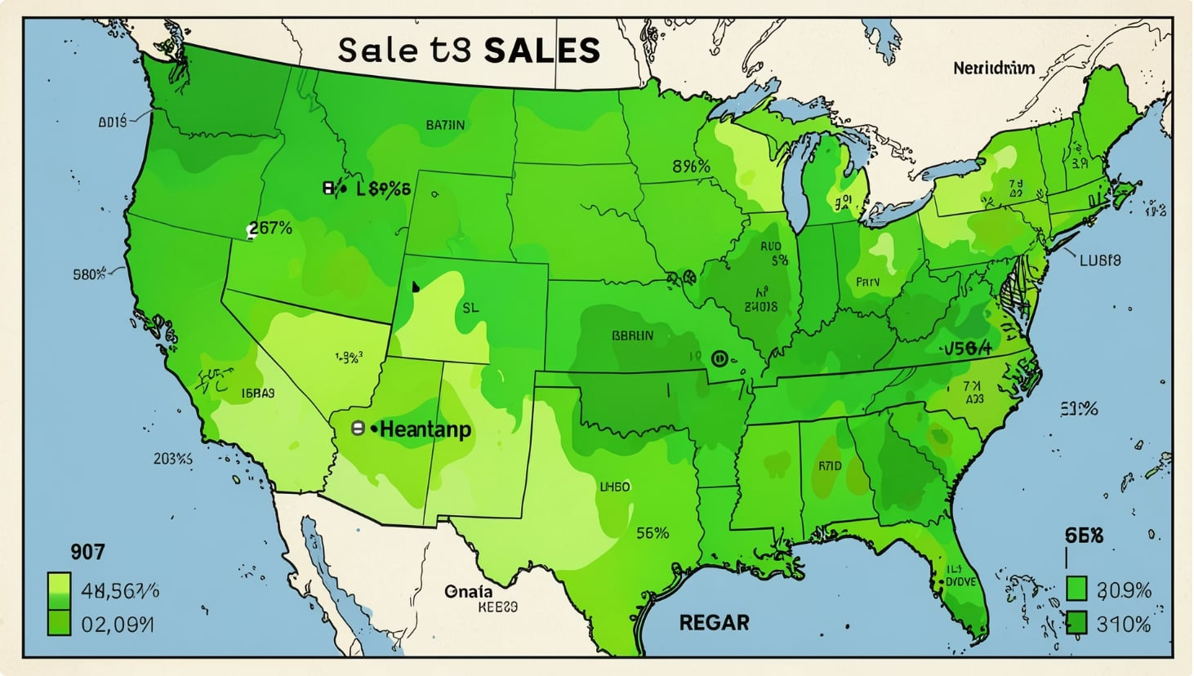

Sales Performance Analysis
Highlights
Revenue growth concentrated in Region A and Product Line X.
Top channels: Direct sales and key reseller partnerships—higher average order value.
Opportunity: Expand high-converting digital channel to adjacent markets.
Action: Reallocate marketing spend toward high-ROI channels for next quarter.

Slide 5
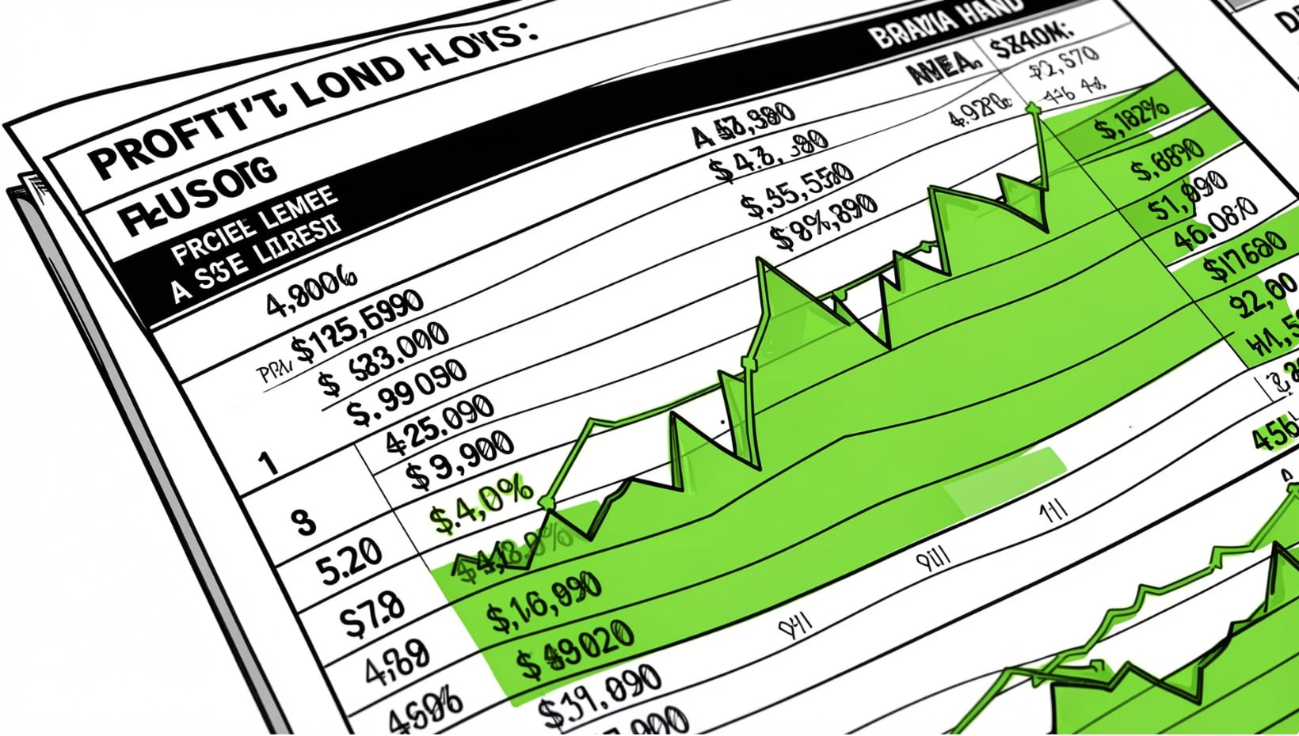

Profitability and Margin Review
Findings
Gross margin improved due to favorable product mix and supplier renegotiations.
Net margin pressure from increased variable expenses—logistics and promotions.
Efficiency wins: process automation reduced operational hours in core fulfillment.
Recommendation: Target non-value add expenses for immediate reduction.

Slide 6

Data Intelligence: Applying SUMIF
Use cases
Sum
SUMIF(range_category, \"Region A\", range_amount) → total revenue for Region A.
SUMIF(product_range, \"Product X\", revenue_range) → product-level sales sums.
Add the values for those rows
Filter
Select rows matching the category
Impact: Automates segmented roll-ups, speeds monthly reporting and reduces manual errors.

Slide 7
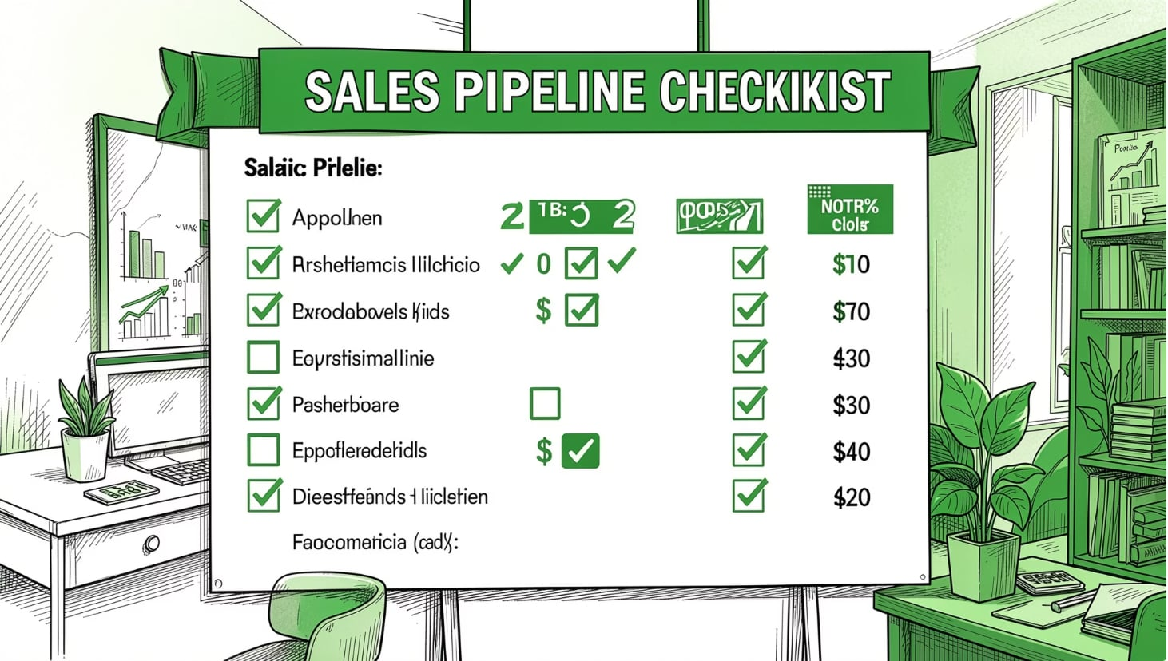
Precision Analytics: Applying COUNTIF
Use cases
COUNTIF(status_range, \"Closed Won\") → number of closed deals in period.
COUNTIF(agent_range, \"=Agent Smith\") → deals attributed to a specific agent.
Impact: Establishes clear volume-based benchmarks and conversion rate denominators for coaching and forecasting.

Slide 8

Efficiency Benchmarking: Applying AVERAGEIF
Use cases
Select Subset
AVERAGEIF(customer_tier_range, \"Premium\", margin_range) → mean margin for premium tier.
Average delivery time by region to spot logistic bottlenecks.
Compute Average
Compare Target
Impact: Identifies outliers and informs targeted interventions to lift overall averages.

Slide 9
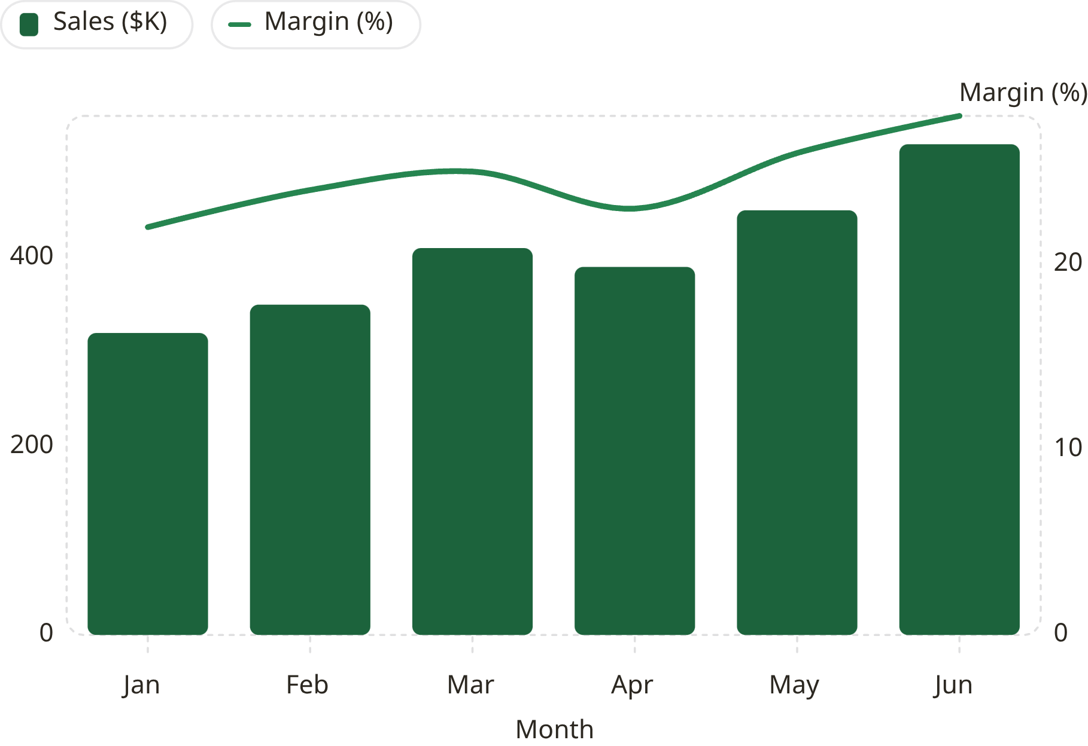
Integrated Dashboard: Putting It All Together
Dashboard notes
Green theme indicates positive performance signals; brown (#3E2513) used for emphasis.
Combine SUMIF, COUNTIF, AVERAGEIF metrics into single-sheet KPIs for dynamic filtering.
Monitor variance between forecast and actuals weekly to catch trends early.
Visualization: Use green hues for growth and the theme brown for critical callouts.

Slide 10

Conclusion and Strategic Next Steps
Recap
Immediate Actions
Accurate KPI tracking using SUMIF/COUNTIF/AVERAGEIF has clarified revenue drivers and margin opportunities.
1) Implement automated formula sheet templates; 2) Centralize FRD ownership; 3) Reinvest in high-ROI channels.
Measure
Commitment
Define monthly targets, track variance dashboards, and run weekly pipeline COUNTIF checks for conversion health.
Data-driven decisions, continuous monitoring, and targeted efficiency programs to sustain growth.

